Slide 1
CLASSES AND OBJECTS

Slide 2
Any concept we wish to represent is encapsulated in a class.
Java class includes instance variables and methods.
Class defines the shape and behavior of an object
Class is a template for an object.
Object is an instance of a class

Slide 3
A Java program consists of one or more classes

Slide 4
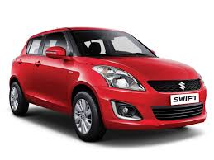



A class is an abstract description of objects
class Car {
...description of a car goes here...
}
some objects of class:

Slide 5
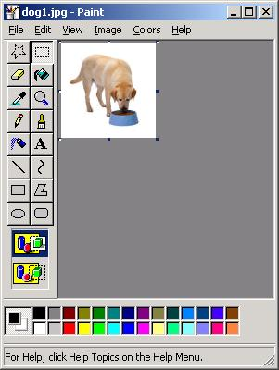
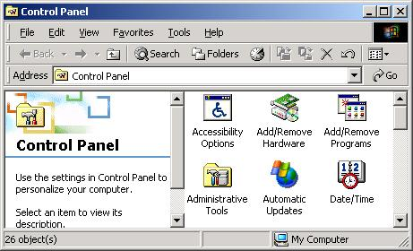
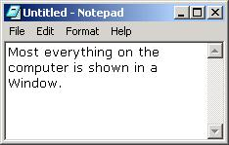
Here is another example of a class:
  class Window { ... }
Some examples of Windows:

Slide 6
Basic Terminology
A class defines a kind of objects:
  specifies the kinds of attributes (data) an object can have.
  provides methods specifying the actions an object can take.
An object is an instance of the class.
Person is a class
  Alice and Bob are objects of the Person class.

Slide 7
What does a class have?
Members of a class:
  Attributes (instance variables)
    For each instance of the class (object), values of attributes can vary.
  Methods
Person class
  Attributes: name, address, phone number
  Methods: change address, change phone number
Alice object
  Name is Alice, address is …
Bob object
  Name is Bob, address is …

Slide 8
class classname
{ type instance-variable1;
// ...
type instance-variableN;
type methodname1(parameter-list)
{ // body of method
}
// ...
type methodnameN(parameter-list)
{ // body of method
}
}

Slide 9
class Box
{
double width;
double height;
double depth;
}

Slide 10

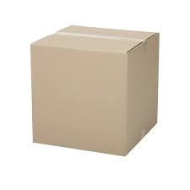
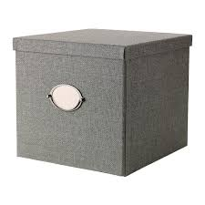
class Box
{
double width;
double height;
double depth;
}

Slide 11
Box mybox = new Box(); // create a Box object

Slide 12
mybox.width = 100;

Slide 13
class Box
{ double width;
double height;
double depth;
}
class BoxDemo
{ public static void main(String args[])
{ Box mybox = new Box();
double vol;
mybox.width = 10;
mybox.height = 20;
mybox.depth = 15;
vol = mybox.width * mybox.height * mybox.depth;
System.out.println("Volume is " + vol);
} }

Slide 14
class BoxDemo2
{ public static void main(String args[])
{ Box mybox1 = new Box();
Box mybox2 = new Box();
double vol;
mybox1.width = 10;
mybox1.height = 20;
mybox1.depth = 15;
mybox2.width = 3;
mybox2.height = 6;
mybox2.depth = 9;
vol = mybox1.width * mybox1.height * mybox1.depth;
System.out.println("Volume is " + vol);
vol = mybox2.width * mybox2.height * mybox2.depth;
System.out.println("Volume is " + vol);
} }

Slide 15
Declaring Objects
Box mybox = new Box();
This statement combines the two steps.
Box mybox; // declare reference to object
mybox = new Box(); // allocate a Box object

Slide 16
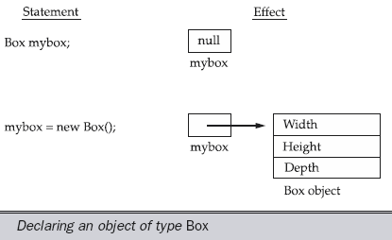

Slide 17
Assigning Object Reference Variables
Box b1 = new Box();
Box b2 = b1;

Slide 18
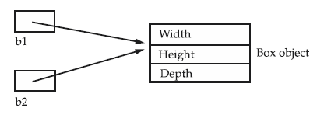

Slide 19
Box b1 = new Box();
Box b2 = b1;
// ...
b1 = null;
b1 has been set to null, but b2 still points to the original object.

Slide 20
Introducing Methods
type name(parameter-list)
{
// body of method
}

Slide 21
Adding a Method to the Box Class
class Box
{
double width;
double height;
double depth;
void volume()
{ System.out.print("Volume is ");
System.out.println(width * height * depth);
}
}

Slide 22
class BoxDemo3
{ public static void main(String args[])
{ Box mybox1 = new Box();
Box mybox2 = new Box();
mybox1.width = 10;
mybox1.height = 20;
mybox1.depth = 15;
mybox2.width = 3;
mybox2.height = 6;
mybox2.depth = 9;
mybox1.volume();
mybox2.volume();
} }

Slide 23
Returning value
class Box
{
double width;
double height;
double depth;
double volume()
{
return width * height * depth;
}
}

Slide 24
class BoxDemo4
{ public static void main(String args[])
{ Box mybox1 = new Box();
Box mybox2 = new Box();
double vol;
mybox1.width = 10; mybox1.height = 20; mybox1.depth = 15;
mybox2.width = 3; mybox2.height = 6; mybox2.depth = 9;
vol = mybox1.volume();
System.out.println("Volume is " + vol);
vol = mybox2.volume();
System.out.println("Volume is " + vol);
} }

Slide 25
// parameterized method.
class Box
{ double width; double height; double depth;
double volume()
{ return width * height * depth; }
void setDim(double w, double h, double d)
{
width = w;
height = h;
depth = d;
}
}

Slide 26
class BoxDemo5
{ public static void main(String args[])
{
Box mybox1 = new Box();
Box mybox2 = new Box();
double vol;
mybox1.setDim(10, 20, 15);
mybox2.setDim(3, 6, 9);
vol = mybox1.volume();
System.out.println("Volume is " + vol);
vol = mybox2.volume();
System.out.println("Volume is " + vol);
}
}

Slide 27
Constructor

Slide 28
Constructor
Constructor is a special type of method.
Constructor has the same name as the class name.
Constructor cannot return values.
Constructor is normally used for initializing objects.
gets invoked “automatically” at the time of object creation.
A class can have more than one constructor.

Slide 29
class Box
{
double width; double height; double depth;
Box()
{
System.out.println("Constructing Box");
width = 10; height = 20; depth = 30;
}
double volume()
{ return width * height * depth; }
}

Slide 30
class BoxDemo6
{ public static void main(String args[])
{
Box mybox1 = new Box();
Box mybox2 = new Box();
double vol;
vol = mybox1.volume();
System.out.println("Volume is " + vol);
vol = mybox2.volume();
System.out.println("Volume is " + vol);
}
}

Slide 31
Parameterized Constructors

Slide 32
class Box
{
double width; double height; double depth;
Box(double w, double h, double d)
{ width = w;
height = h;
depth = d;
}
double volume()
{ return width * height * depth; }
}

Slide 33
class BoxDemo7
{ public static void main(String args[])
{
Box mybox1 = new Box(10, 20, 15);
Box mybox2 = new Box(3, 6, 9);
double vol;
vol = mybox1.volume();
System.out.println("Volume is " + vol);
vol = mybox2.volume();
System.out.println("Volume is " + vol);
}
}

Slide 34
this keyword
Box(double w, double h, double d)
{
this.width = w;
this.height = h;
this.depth = d;
}

Slide 35
instance variable hiding
// to resolve name-space collisions.
Box(double width, double height, double depth)
{
this.width = width;
this.height = height;
this.depth = depth;
}

Slide 36
// This class defines an integer stack that can hold 10 values.
class Stack
{ int stck[] = new int[10];
int tos;
Stack()
{ tos = -1;
}
void push(int item)
{
if(tos==9)
System.out.println("Stack is full.");
else
stck[++tos] = item;
}

Slide 37
// Pop an item from the stack
int pop()
{
if(tos < 0)
{
System.out.println("Stack underflow.");
return 0;
}
else
return stck[tos--];
}
}

Slide 38
class TestStack
{ public static void main(String args[])
{
Stack mystack1 = new Stack();
Stack mystack2 = new Stack();
for(int i=0; i<10; i++)
mystack1.push( i );
for(int i=10; i<20; i++)
mystack2.push( i );
System.out.println("Stack in mystack1:");
for(int i=0; i<10; i++)
System.out.println(mystack1.pop());
System.out.println("Stack in mystack2:");
for(int i=0; i<10; i++)
System.out.println(mystack2.pop());
}
}

Slide 39
Stack in mystack1:
9
8
7
6
5
4
3
2
1
0
Stack in mystack2:
19
18
17
16
15
14
13
12
11
10
.

Slide 40
OVERLOADING METHODS

Slide 41
class OverloadDemo
{
void test()
{ System.out.println("No parameters");
}
void test(int a)
{ System.out.println("a: " + a);
}
void test(int a, int b)
{ System.out.println("a and b: " + a + " " + b);
}
double test(double a)
{ System.out.println("double a: " + a);
return a*a;
}
}

Slide 42
class Overload
{ public static void main(String args[])
{
OverloadDemo ob = new OverloadDemo();
double result;
ob.test();
ob.test(10);
ob.test(10, 20);
result = ob.test(123.25);
System.out.println("Result of ob.test(123.25): " + result);
}
}

Slide 43
// Automatic type conversions apply to overloading.
class OverloadDemo
{ void test()
{ System.out.println("No parameters");
}
void test(int a, int b)
{ System.out.println("a and b: " + a + " " + b);
}
void test(double a)
{ System.out.println("Inside test(double) a: " + a);
}
}

Slide 44
class Overload
{ public static void main(String args[])
{
OverloadDemo ob = new OverloadDemo();
int i = 88;
ob.test();
ob.test(10, 20);
ob.test(i); // this will invoke test(double)
ob.test(123.2); // this will invoke test(double)
}}
Eg. : Overloading Sum() with different parameter types and numbers

Slide 45
OVERLOADING CONSTRUCTORS

Slide 46
class Box
{ double width; double height; double depth;
Box(double w, double h, double d)
{ width = w; height = h; depth = d; }
Box()
{ width = -1; // use -1 to indicate
height = -1; // an uninitialized
depth = -1; // box }
Box(double len)
{ width = height = depth = len; }
double volume()
{ return width * height * depth; } }

Slide 47
class OverloadCons
{ public static void main(String args[])
{
Box mybox1 = new Box(10, 20, 15);
Box mybox2 = new Box();
Box mycube = new Box(7);
double vol;
vol = mybox1.volume();
System.out.println("Volume of mybox1 is " + vol);
vol = mybox2.volume();
System.out.println("Volume of mybox2 is " + vol);
vol = mycube.volume();
System.out.println("Volume of mycube is " + vol); }}

Slide 48
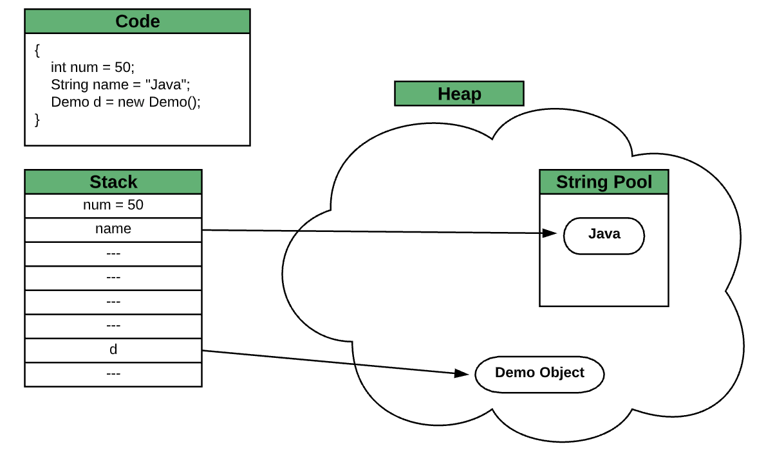
Stack , Heap Memory, and String Pool

Slide 49

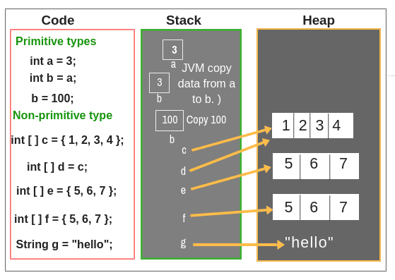
Memory Allocation of Primitive, Non-primitive Data Types

Slide 50
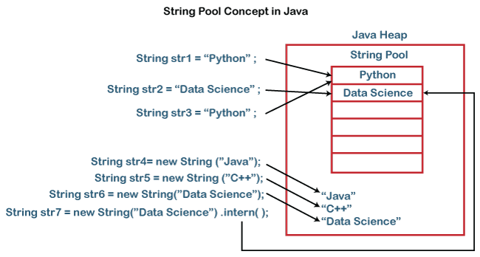
String Pool in java

Slide 51
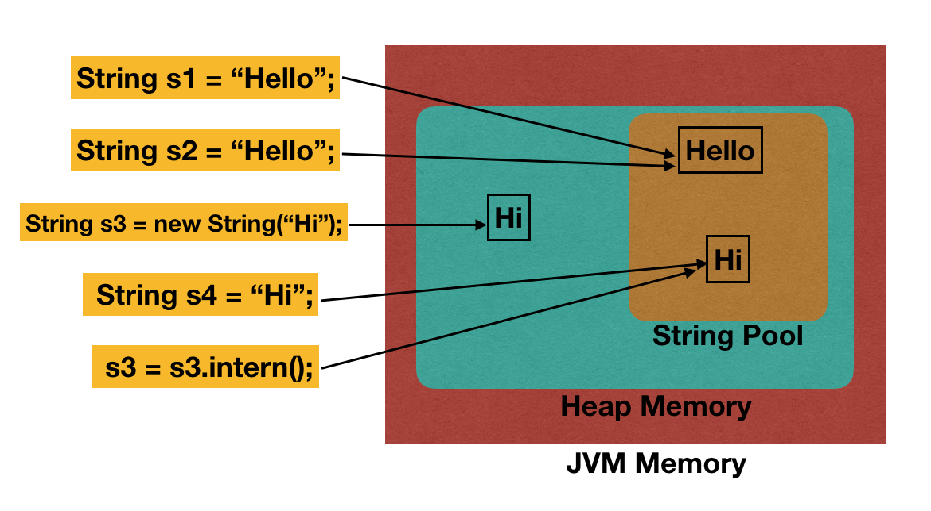
String Pool in Heap Memory

Slide 52
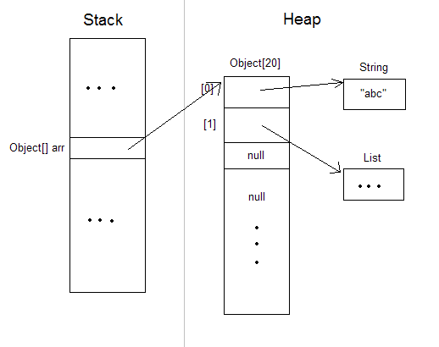
Array saved in memory

Slide 53
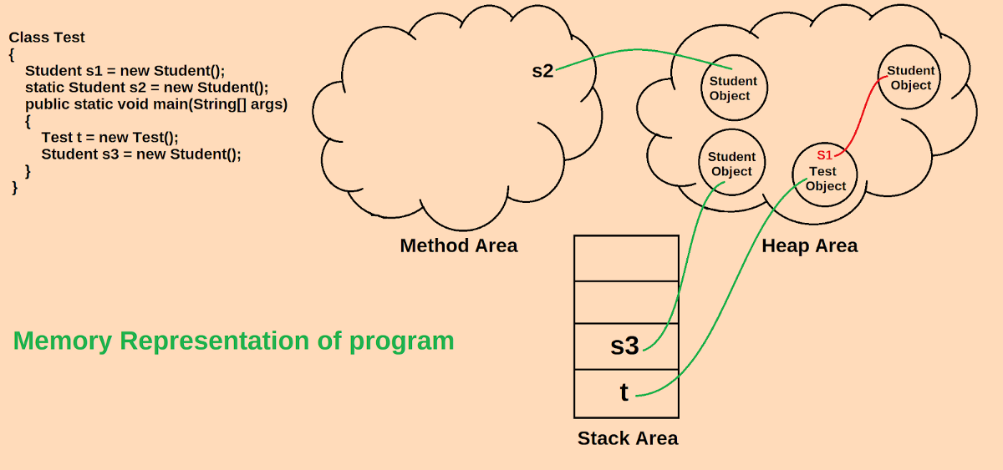
Objects and References are stored in JVM memory area

Slide 54
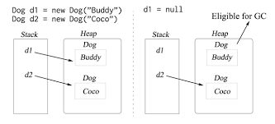
Garbage Collector

Slide 55
Using object as a parameter

